Slide 1
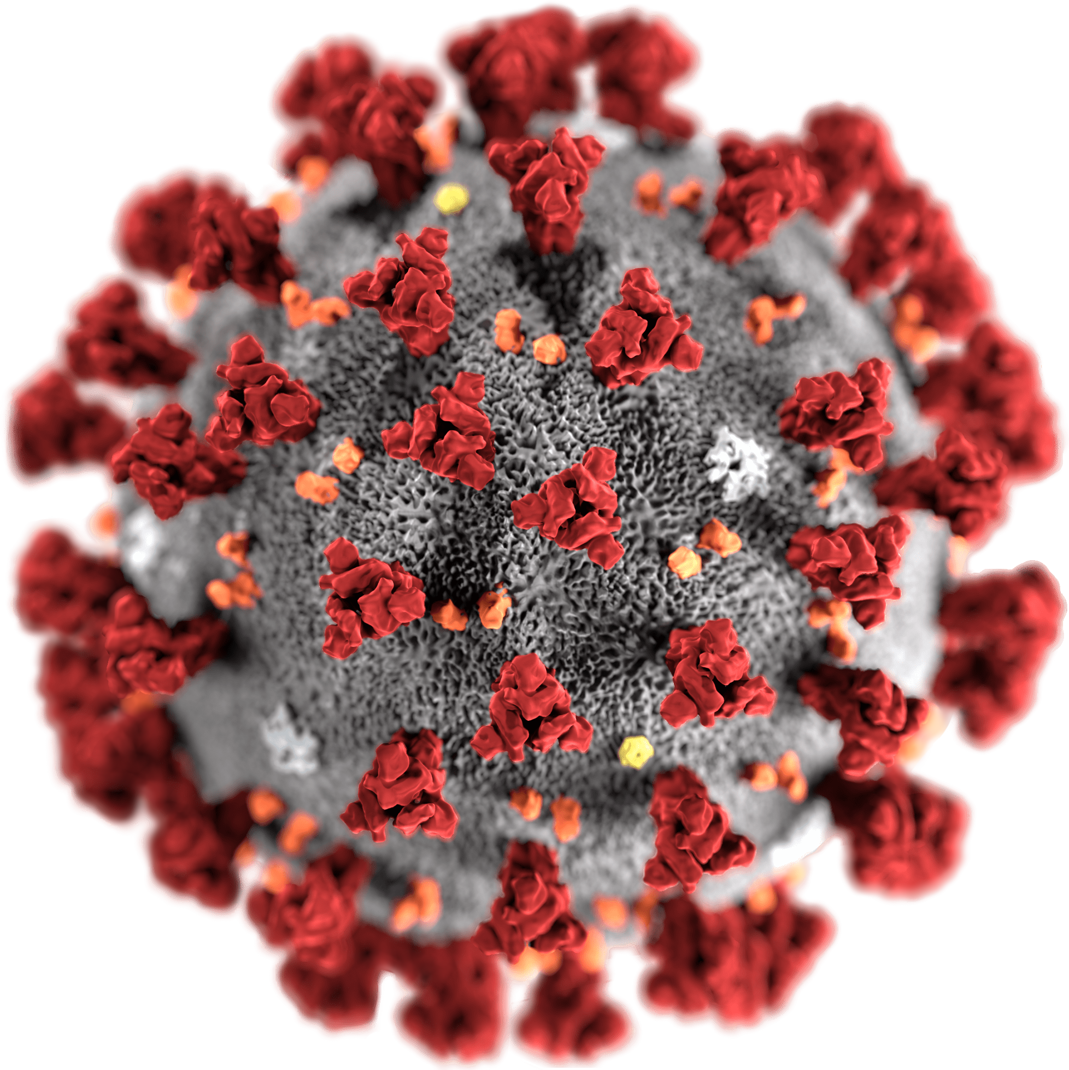
COVID-19 update Joel Valcarcel MD, FAAFP Associate Program Director Fort Wayne Medical Education Program Family Medicine Residency

Slide 2
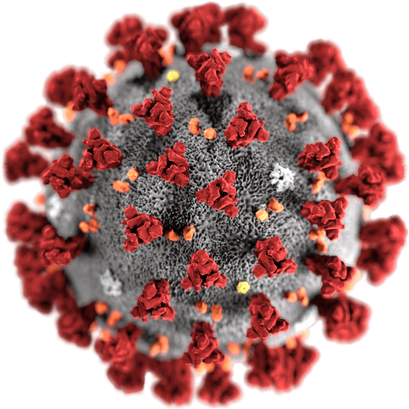
Before we begin:
Information and recommendations change quickly. This presentation was most recently revised on 4/3/2020
I have no financial conflicts of interest to disclose
Guidelines exist, but specific infection control protocols are decided locally, not globally. Follow the guidance of your specific institution, infection control officer, or City/County/State Board of Health

Slide 3
COVID-19 SARS-CoV-2
Disease
Virus Name

Slide 4
7 Human Coronaviruses: 4 “normal”; 3 “novel”
Alpha: HCoV-229E, HCoV-NL63 Beta: HCoV-HKU1, HCoV-OC43, MERS-CoV, SARS-CoV, SARS-CoV-2

Slide 5
Coronavirus Structure
Medium-sized virus
Enveloped, positive stranded RNA
Largest mRNA genome of any virus
mRNA encased in nucleocapsid
Lipid Bilayer – Soap works to disrupt this!
Corona = Crowns for Spikes
Glycoprotein Spike (S) Peptomer
Spikes allow it to attach to human cell receptors in upper or lower airway

Slide 6
Viral Respiratory Infections
The four “normal” coronaviruses predominately attach to receptors in UPPER airway
URI symptoms, croup, dry cough, rarely pneumonia (except sometimes NL63)
“Normal” human coronaviruses cause 10-30% of common cold/URIs
229E and NL63 (alpha coronaviruses)
OC43 and HKU1 (beta coronaviruses)
Seasonality is unpredictable, different in tropics than temperate regions
Other URI viral pathogens:
Rhinovirus, Influenza, Adenovirus, Parainfluenza, Respiratory syncytial virus, Human metapneumovirus

Slide 7
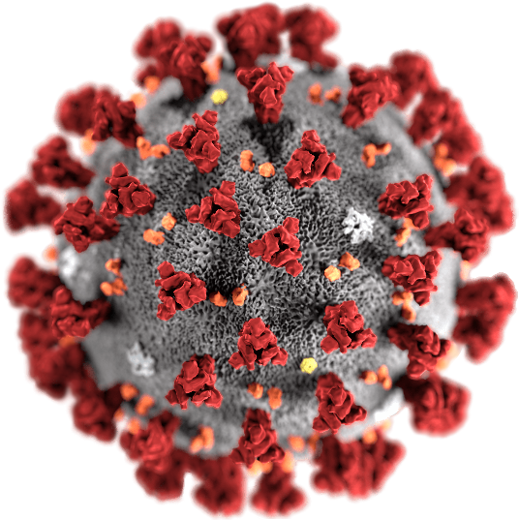
“Novel” Coronaviruses
The novel coronaviruses attach predominantly to receptors in the LOWER respiratory tract
SARS, MERS, SARS-CoV-2
Other LRIs/Viral Pneumonias: Influenza (A/B), Adenovirus, Parainfluenza (Type 1-4), Respiratory syncytial virus, Human metapneumovirus, NL63
SARS (2002-2003): Contained. Case Fatality Rate is ~10%. >50% mortality in patients >60 y/o.
MERS: Not Contained. CFR ~35%.
High healthcare worker infection and other nosocomial spread was seen in previous outbreaks

Slide 8
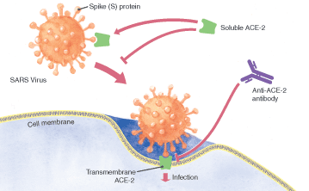
Novel CoV attachment
ACE-2 Receptor
Bronchial epithelia and Type 2 Alveolar Cells
Heart
Kidney
GI tract
SARS-CoV-2 binds 10-20x more strongly than SARS-CoV
Some upper airway attachment
Question of ADEs (Antibody Dependent Enhancement) being present
Antibodies creating a backdoor enhancement for viral replication
Implications on vaccine development safety
For video on how virus replication in cells occurs: https://www.youtube.com/watch?v=Eeh054-Hx1U

Slide 9
Antibody Dependent Enhancement
We know that a certain level of antibodies are required to neutralize a virus
Below this threshold, Antibody-dependent enhancement can occur when non-neutralizing antiviral proteins (i.e., antibodies) facilitate virus entry into host cells, leading to increased infectivity in the cells.
How is virus entry facilitated? Some cells do not have the usual receptors on their surfaces that viruses use to gain entry. Antibodies can bind to antibody Fc receptors that these cells have in the plasma membrane. A virus can then attach to the antigen binding site at the other end of the antibody.
ADE is common in cells cultured in the laboratory, but rarely occurs in vivo except for dengue virus. Dengue virus can use this mechanism to infect human macrophages, causing a normally mild viral infection to become life-threatening

Slide 10
Questions regarding ACE-I/ARB therapy
The expression of ACE2 is increased in patients with type 1 or type 2 diabetes. Hypertension is also treated with ACE inhibitors and ARBs, which may also result in an upregulation of ACE2.
It’s hypothesized that diabetes and hypertension treatment with ACE2-stimulating drugs can increase the risk of developing COVID-19 (Lancet Respir Med 3/11/2020 https://www.thelancet.com/journals/lanres/article/PIIS2213-2600(20)30116-8/fulltext)
However, the position statement of the ESC (European Society of Cardiologists) on 3/13/2020 strongly recommends continuing ACE or ARB therapy, citing the lack of clear scientific or clinical evidence that ACE/ARB should be discontinued in the context of COVID-19

Slide 11
What about NSAIDS?
The Health Minister of France, Oliver Veran, sent out a tweet on 3/14/2020 raising concerns about this. The WHO initially sent out an advisory to avoid NSAID use in an abundance of caution. This recommendation has since been reversed.
The CDC and NIAID (through Dr. Fauci) and England’s NHS have reiterated that there’s no clinical or scientific evidence to back the claim that NSAIDS can make COVID19 symptoms worse

Slide 12
Seasonality and Mutation Rate
Unknown. Some CoV’s are seasonal in Northern Hemisphere; MERS is not.
SARS-CoV-2 is mutating, which complicates things. Virulence and transmission may shift over time.
This may explain why initial reports from Wuhan described a higher mortality rate than more recent case series (Tang, et. Al., 2020; Xu, et. Al., 2020)
Strains: in 103 patients, 72 patients had L type (more virulent) and 29 had S type (wild type/apparent first strain). Lethality difference unclear. Phylogenetic mapping is ongoing.
Normally viruses get more benign over time. However, delayed symptom onset, supportive care (delaying death), poor access to testing and diagnosis, isolation, contact tracing and quarantine makes deadly strains persist

Slide 13
Pathophysiology
(1) ARDS
The primary pathology in hospitalized patients is ARDS. ARDS in COVID19 patients is characterized by diffuse alveolar damage (e.g. including hyaline membranes). Pneumocytes with viral cytopathic effect are seen, implying that direct virus damage is also present, rather than a purely hyper-inflammatory injury (Xu et al 2/17).
(2) Cytokine storm
Emerging evidence suggests that some patients may respond to COVID-19 with an exuberant “cytokine storm” reaction leading to direct tissue damage and features similar to bacterial sepsis (this phenomenon is called hemophagocytic lymphohistiocytosis [HLH] for you nerdy types).
Clinical markers of this may include elevations of C-reactive protein and ferritin, which appear to track with disease severity and mortality (Ruan 3/3/20)

Slide 14
Stages of Illness
There seem to be different stages of illness that patients may move through.
Replicative stage – Viral replication occurs over a period of several days. An innate immune response occurs, but this response fails to contain the virus. Relatively mild symptoms may occur
Adaptive immunity stage – An adaptive immune response eventually kicks into gear. This leads to falling titers of virus. However, it may also increase levels of inflammatory cytokines and lead to tissue damage causing clinical deterioration. (Mehta et al.).
This may explain the clinical phenomenon wherein patients are relatively OK for several days, but then suddenly deteriorate when they enter the adaptive immunity stage (e.g. Young et al. 3/3/2020).

Slide 15
Stages of Illness
COVID-19 having distinct stages of illness has potentially important clinical implications:
Initial clinical symptoms may not be predictive of future deterioration. Strategies are needed for risk-stratification and disposition.
Anti-viral therapies might need to be deployed early to work optimally (during the replicative stage).
Immunosuppressive therapy (e.g. low-dose steroids) might be best initiated during the adaptive immune stage (with a goal of blunting this immunopathologic response slightly in the sickest patients). But this is purely speculative.

Slide 16
Transmission
Novel: There is no herd immunity and no antibody cross-reactions
Incubation: typically 2-14 days, median is 4 days. Outlier of 27 days
Symptom onset: median is Day 5-6 from exposure
Transmission is through respiratory droplets and hand-to-mucus-membrane contact.
May survive on plastics, porcelain, steel for up to 9 days
Hand hygiene and not touching your face is important. A surgical mask may be helpful as it acts as a barrier that prevents you from touching your mouth or nose
Airborne transmission would imply the need for N95 masks rather than surgical masks. Intubation, BiPAP, and suctioning causes aerosolization

Slide 17
When can transmission occur?
Transmission appears to occur over roughly ~8 days following the start of illness. Asymptomatic transmission appears to be possible (Carlos del Rio 2/28).
Initial WHO data from cases in China show that asymptomatic cases were relatively rare and not a big driver of transmission
However, new data from China’s National Health Commission from 4/1/2020 was made available. A total of 130 of 166 new infections (78%) identified in the 24 hours prior to the afternoon of Wednesday 1 April were asymptomatic
https://www.bmj.com/content/bmj/369/bmj.m1375.full.pdf
This has not been confirmed by other studies, but if this is accurate, it would seem that the virus is more widespread than previously thought, and asymptomatic transmission may be a big driver for transmission.

Slide 18
Transmission
Patients may continue to have positive pharyngeal PCR for weeks after convalescence (Lan 2/27). However, virus culture methods are unable to recover viable virus after ~8 days of clinical illness (Wolfel 2020).
This implies that prolonged PCR positivity probably doesn't correlate with clinical virus transmission. However, all subjects in this study had mild illness, so prolonged transmission in severe cases remains a possibility.
CDC guidance is still vague on how long patients with known COVID-19 should be isolated.

Slide 19
Basic reproduction index: R⌀ (“R naught”)
R⌀ is the average number of people that an infected person transmits the virus to.
Current estimates put R⌀ at ~2.5-2.9 (Peng PWH et al, 2/28).
R⌀ is a reflection of both the virus and also human behavior. Interventions such as social distancing and improved hygiene will decrease R⌀.
Control of spread of COVID-19 in China proves that R⌀ is a modifiable number that can be reduced by effective public health interventions.
The R⌀ on board the Diamond Princess cruise ship was 15 – illustrating that cramped quarters with inadequate hygiene will increase R⌀ (Rocklov 2/28).

Slide 20
How infectious is it?
R⌀ typically cited as 2-3 but may be as high as 4.9; this varies based on population density and exposure patterns
Probably about twice as transmissible as influenza

Slide 24
Typical Disease Course
Week 1:
(77-98%) majority report fever to be intermittent vs. persistent. Absence of fever does not exclude COVID-19
up to 10% of patients can present initially with gastrointestinal symptoms (e.g. diarrhea, nausea), which can precede the development of fever and dyspnea (Wang et al. 2/7/20).
Weakness/Malaise (11-52%), dry cough (46-82%), shortness of breath (3-31%), less common: headache, sputum production, sore throat, nasal congestion
80% of patients will be mild/moderate cases. Completely asymptomatic patients are rare.
Physical examination is generally nonspecific. About 2% of patients may have pharyngitis or tonsil enlargement (Guan et al 2/28).
Week 2:
(day 6-9): ~ 15% develop dyspnea from viral pneumonia requiring hospitalization and supportive care.
Week 2-3:
5% of hospitalized patients require ICU, most with ARDS. at least half of these patients will require intubation. Multiorgan failure, AKI, and cardiomyopathy with cardiogenic shock are late sequelae.

Slide 25
General Prognosis
(1) It remains unclear what fraction of patients are hospitalized.
There may be lots of patients with mild illness who don't present to medical attention and aren't counted.
The vast majority of infected patients (e.g. >80%) don't get significantly ill and won't require hospitalization.
(2) Among hospitalized patients (Guan et al 2/28)
~10-20% of patients are admitted to ICU.
~3-10% require intubation.
~2-5% die.
(3) Longer term outcomes: Prolonged ventilator dependency ?
Patients who survive the initial phases of the illness may still require prolonged ventilator support (possibly developing some radiographic elements of fibrosis)(Zhang 2020).
As the epidemic progresses, an issue which may arise is a large volume of patients unable to wean from mechanical ventilation.

Slide 26
Prognosis
Age and pre-existing cardiovascular disease are the biggest risk factors
Pediatric populations have done well in the pandemic so far. In the published data from China’s CDC, a review of 72,314 cases showed that only 171 children <10 y/o were found to be COVID19 positive (0.24%).
3 patients required ICU support, but all 3 patients had pre-existing conditions – hydronephrosis, leukemia, and intussusception.
There has been one death (the 10 month old child who had intussusception and COVID19 died 4 weeks after admission).
The study concluded on 3/8/2020. As of that date, 141 of the 171 pediatric patients have been discharged and 29 are in stable condition in general wards.

Slide 27
Prognosis
Prolonged mechanical ventilation (2-4 weeks) is common
Findings that seem to correlate with poorer prognosis:
Elevated D-dimer (indicating DIC?), troponin, or CK-MB;
worsening lymphopenia or thrombocytopenia, and
a neutrophil to lymphocyte ratio >3

Slide 28
Typical findings:
Most Common:
Lymphopenia, Low Procalcitonin, CRP is often elevated and seems to track disease severity
Increased ALT/AST in the 70-100 range, Occasional increased alkaline phosphatase
Mild AKI
CXR:
Bilateral patchy or reticular infiltrates, perihilar infiltrates occasionally
CT scan
Bilateral diffuse ground glass opacities, multifocal patchy consolidation, interstitial changes
Hallmark finding; present in 86% of hospitalized patients in the case series
ECHO:
Normal EF prior to late-onset sudden cardiogenic shock with EF <10%
No wall motion abnormalities, normal LV function.
Co-infection is rare but possible (2%)

Slide 30
Labs
CBC
WBC count tends to be normal, but lymphopenia is seen in ~80% of patients (Guan et al 2/28, Yang et al 2/21).
Mild thrombocytopenia (platelets counts are rarely <100K) is a common finding. Lower platelet count is a poor prognostic sign (Ruan et al 3/3).
Coagulation studies
Coagulation labs are generally normal upon admission, except elevated D-dimer is commonly seen.
Disseminated intravascular coagulation may evolve over time, correlating with poor prognosis (Tang et al. 2020).

Slide 31
Labs:
Inflammatory markers
Procalcitonin
COVID-19 does not appear to increase procalcitonin. The largest series found that procalcitonin levels were <0.5 in 95% of patients (Guan et al 2/28).
Elevated procalcitonin may suggest an alternative diagnosis (e.g. pure bacterial pneumonia). For patients who are COVID-19 positive, procalcitonin elevation may suggest a superimposed bacterial infection.
C-reactive protein (CRP)
COVID-19 increases CRP. This seems to track with disease severity and prognosis. In a patient with severe respiratory failure and a normal CRP, consider non-COVID etiologies (such as heart failure).

Slide 32
Labs:
Troponin elevation
Elevated troponin is common, specially high-sensitivity troponin. This is a strong predictor of mortality (as is generally true for troponin elevation among critically ill patients).
Troponin elevation generally doesn't represent a type-I (plaque rupture) myocardial infarction. As such, these elevations require no specific therapy.
The value of measuring and cycling troponin is dubious. Evaluation should probably focus on EKG findings, because EKG findings of coronary occlusion would much greater implications for clinical management (true coronary occlusion is probably rare, but can occur in any patient under physiologic stress).

Slide 33
Labs
Respiratory BioFire/Rapid Respiratory Panel may be helpful. Detection of other respiratory viruses doesn't exclude co-infection with COVID-19, but co-infection is rare (~2%) and an alternative explanation for the patient's symptoms reduces the index of suspicion for COVID-19 substantially.
Conventional viral panels available in hospitals will test for “coronavirus.”
This PCR test for “coronavirus” is designed to evaluate for the four normal coronaviruses which usually cause mild illness. This test will NOT work for the novel coronaviruses, including COVID-19
However, there is evidence that a positive conventional test for “coronavirus” actually makes it less likely that the patient has COVID-19.
Blood cultures should be performed as per usual indications.

Slide 34
Imaging
The typical finding is patchy ground glass opacities, which tend to be predominantly peripheral and basal (Shi et al 2/24). The number of involved lung segments increases with more severe disease. Over time, patchy ground glass opacities may coalesce into more dense consolidation.
Infiltrates may be subtle on chest X-ray
Findings which aren't commonly seen, and might argue for an alternative or superimposed diagnosis:
Pleural effusion is uncommon (seen in only ~5%).
COVID-19 doesn't appear to cause masses, cavitation, or lymphadenopathy.

Slide 35
Other features/considerations
Cardiomyopathy
Fulminant cardiomyopathy can occur. This may be a late feature, which can occur even after patients are recovering from respiratory failure.
Cardiogenic shock appears to be an important cause of death, contributing to ~7-33% of deaths (Ruan 3/3/20).
It's unclear whether this represents a viral cardiomyopathy (virus can be recovered from myocardial tissue), stress cardiomyopathy, or cardiac dysfunction due to cytokine storm (i.e., a feature of virus-induced hemophagocytic lymphohistiocytosis).

Slide 36
AKI/Renal failure
Renal failure requiring dialysis is reported in a subset of patients admitted to ICU.
The exact mechanism is unclear at this point, but some conjectures may be reached based on SARS (Chu et al. 2005).
SARS causes renal failure in ~7% of patients. Pathology is acute tubular necrosis, likely from multi-organ failure. Rhabdomyolysis may have contributed as well. Renal failure correlates with a poor overall prognosis (92% mortality with renal failure versus 9% without). In multivariable analysis, renal failure was the strongest predictor of mortality (more-so even than ARDS).

Slide 38
Supportive Therapy - High flow nasal cannula?
Considered when patients “fail” on low flow oxygen via nasal cannula
Concerns have been raised that using HFNC could increase the risk of viral transmission, but there is no solid evidence to support this.
WHO guidelines on COVID-19 state that “Recent publications suggest that newer HFNC and NIV systems with good interface fitting do not create widespread dispersion of exhaled air and therefore should be associated with low risk of airborne transmission.”

Slide 39
High Flow Nasal Cannula
Other reasons that HFNC might not increase viral transmission are:
HFNC supplies gas at a rate of ~40-60 liters/minute, whereas a normal cough achieves flow rates of ~400 liters/minute (Mellies 2014).
HFNC requires less maintenance than invasive mechanical ventilation.
The intubation procedure places healthcare workers at enormous risk of acquiring the virus, so intubation with a goal of reducing transmission is probably counterproductive
Very limited data, but existing evidence does not support the concept that HFNC increases pathogen dispersal substantially. (Leung 2018, Roberts 2015).
One possible compromise might be to use HFNC with a moderate rate of flow (e.g. 15-30 liters/minute, rather than 40-60 liters/minute).
Since 15-30 liters/minute flow is close to a baseline minute ventilation for a sick respiratory failure patient, adding this level of flow is unlikely to affect matters substantially.

Slide 40
When to transition from HFNC to intubation
COVID-19 may cause hypoxemia with relatively little respiratory distress (“silent hypoxemia”). Patients may be profoundly hypoxemic yet not be dyspneic – and such patients may “look” fine. Therefore, work of breathing cannot be relied upon to detect patients who are failing HFNC.
Exactly when to intubate is always a clinical decision. Progressively rising FiO2 requirements should be a signal to consider intubation (e.g. requirement of perhaps more than ~75% FiO2??).

Slide 41
When to transition from HFNC to intubation
There should probably be a lower threshold to intubate in COVID-19:
Patients can develop worsening “silent” atelectasis and decline abruptly, without lots of symptoms.
Oxygenation techniques used to maintain saturation during intubation may increase virus aerosolization. Rapid sequence intubation without bagging is preferred. This will be safer if the patient is starting out with more oxygenation reserve.
A GlideScope can be used as well
Intubation requires considerable preparation, so a semi-elective intubation is preferred to crash intubation.

Slide 42
BiPAP?
Traditional BiPAP probably isn't useful for most patients
Reasons to avoid BiPAP:
In a multicenter cohort of 302 patients with MERS coronavirus, 92% of patients treated with BiPAP failed this modality and required intubation (Alraddadi 2019).
In the FLORALI trial of ARDS patients (with mostly pneumonia of various etiologies), patients randomized to BiPAP did worse compared to patients randomized to HFNC.
BiPAP could have a niche role in patients with combined syndromes (e.g. COPD plus COVID-19). If BiPAP is used, a viral filter should be placed in-line with the exhalation tubing to reduce environmental contamination.

Slide 43
ECMO?
Patients with COVID-19 can be relatively young and suffering from single-organ failure due to a reversible etiology, so many would be excellent candidates for ECMO.
VV ECMO could be used for respiratory failure (although it's unclear how common true refractory hypoxemia is).
VA ECMO could be useful in patients with fulminant cardiomyopathy and cardiogenic shock
Exact indications and timing are unclear.
In an epidemic, ECMO capabilities would probably rapidly become saturated. Very thorny ethical issues could arise (e.g. how long of an ECMO run is one patient allowed to have before the withdrawal of life-sustaining therapy, in order to allow the circuit to be used for another patient?).

Slide 44
Key Principle : Manage viral pneumonia!
Avoid COVID-19 exceptionalism
We know how to treat severe viral pneumonia and ARDS. We've been doing this for years.
There is not yet any compelling evidence that the fundamentals of treating COVID-19 are substantially different from treating other forms of viral pneumonia (e.g. influenza).
The essential strategy of treatment for COVID-19 is supportive care, which should be performed as it would be done for any patient with severe viral pneumonia. For example, if you were to simply treat the patient as if they had influenza (minus the oseltamivir), you would be doing an excellent job.

Slide 45
Treatment
Supportive Care:
O2 support, but may have rapid symptom progression and need for HFNC and intubation
Antibiotics are probably NOT helpful (secondary bacterial infections were rare)
The role of steroids are unclear. Steroid tx could:
1. increase viral levels, shedding time and virus-induced lung damage (increases mortality) 2. reduce the pathological hyper-immune response to the virus (beneficial for ARDS)
High dose pulsed steroids are NOT currently recommended. Maybe lower dose of methylprednisolone or prednisone? Should we stop ICS for COPD patients who are not in acute exacerbation? Data is unclear.
ARDS
As discussed earlier. Avoid BiPAP if possible
Airway pressure release ventilation (APRV), Paralysis, Prone positioning
Flolan (epoprostenol – indicated for pulmonary HTN; Distribution in US is restricted)

Slide 46
Treatment:
Avoid aggressive fluid resuscitation
Patients rarely are shocked on admission (even among critically ill patients, admission blood pressure is generally normal and lactate elevations are mild-moderate)(Yang et al 2/21).
Overall, the rate of reported “sepsis” is generally low (<5%). The virus doesn't seem to generally cause a septic shock picture (but of course, patients may always suffer from superimposed bacterial septic shock).
The cause of death from COVID-19 is nearly always ARDS – which may be exacerbated by fluid administration.
Gentle fluid administration could be considered for patients with evidence of hypoperfusion and a history suggestive of total body hypovolemia (e.g. prolonged nausea/vomiting and diarrhea).

Slide 47
Medications:
Remdesivir might be an excellent antiviral, based on a study involving in vitro and animal data with MERS (e.g. Sheahan 2020).
Not commercially available. Remdesivir was used on the basis of “compassionate use” for one of the first patients with COVID-19 in the United States (Holshue 2020).
Remdesivir is being used in one trial in the United States being sponsored by NIAID. Enrollment in this trial is likely the most feasible approach to being able to use Remdesivir.

Slide 48
Lopinavir/Ritonavir (KALETRA)
Results of a clinical trial were published in the NEJM (3/18/2020)
Clinical trial of 199 COVID19(+) patients
99 randomized to the treatment group, 100 as controls
No benefit seen with Lopinavir/Ritonavir
Ribavirin may be synergistic w/ lopinavir/ritonavir. Possible concern about using all 3 as a cocktail in future trials would be having to use 3 medications in very sick patients when 2 of the 3 meds in the cocktail have already been shown to not have a benefit.

Slide 49
Chloroquine
Has anti-viral activity in vitro, but no established track record in treatment of viral disease. It’s widely used as malaria prophylaxis and amebiasis, but at a much lower dose than what’s considered for COVID-19.
Mechanism of action
Interference with viral attachment to the ACE-2 receptor
Impairment of acidification of endosomes, which disrupts virus trafficking within cells.
Chloroquine also has immunosuppressive activities. Unknown if this immunosuppressive effect will be beneficial or harmful in COVID-19 (like steroid therapy).
in vitro and animal data
Chloroquine can inhibit COVID-19 in vitro with an 50% inhibitory concentration of 1 uM, implying that therapeutic levels could be achieved in humans (Wang 2020).
In a previous study, Chloroquine failed to work in mice infected with SARS (Bernard 2006).
However, The 50% inhibitory concentration of chloroquine for SARS is ~9 uM, suggesting that it could be more effective against COVID-19 than SARS (Al-Bari 2017).
Human data
Emerging reports from China suggests that chloroquine has been studied with favorable results, but the data is currently not available (Gao 2020). Hopefully, this clinical data will be published shortly.

Slide 50
Hydroxychloroquine
Hydroxychloroquine:
Yao et al. found that the hydroxychloroquine was much more potent than chloroquine at inhibition of COVID-19 in cell lines (EC50 of 0.7 uM vs. 5 uM, respectively). They recommended a regimen of 400 mg BID for the first day followed by 200 mg BID for the following four days.
Gautret et al: Hydroxychlorquine and azithromycin (Marseille study)
Non-randomized, open label study evaluating the use of hydroxychloroquine (200 mg TID) with or without azithromycin (500 mg once, followed by 250 mg daily for four days).
The primary endpoint was reduction in viral load. This was reduced, especially by the combination of chloroquine plus azithromycin.

Slide 51
Dosing (per the clinical trials)
Chloroquine
500 mg PO twice daily for 10 days is the regimen recommended by a group in China for patients without contraindications (Zhi 2020).
50% dose reduction if CrCl is <10. No established dosing guideline in hepatic dysfunction.
Hydroxychloroquine
400 mg PO BID on day #1, then 200 mg q12 hrs for 5-10 days (Regimen used by U. Pennsylvania and Belgium Guidelines)
200 mg TID for 10 days (Gautret et al regimen)
No dosing adjustment for renal or hepatic dysfunction, or obesity.

Slide 52
Chloroquine and Hydroxychloroquine
Despite the lack of any large scale RCT on the safety or efficacy of chloroquine and hydroxychloroquine for COVID19, an Emergency Use Authorization (EUA) was granted by the U.S. FDA on 3/28/2020 for this indication.

Slide 53
Convalescent plasma
Use of convalescent plasma has been studied in outbreaks of other respiratory infections, including the 2009-2010 H1N1 influenza virus pandemic, 2003 SARS-CoV-1 epidemic, and the 2012 MERS-CoV epidemic.
Although promising, convalescent plasma has not been shown to be effective in every disease studied.
It is therefore important to determine through clinical trials, before routinely administering convalescent plasma to patients with COVID-19, that it is safe and effective to do so.
On 3/24/2020, The FDA encouraged to submit requests to FDA for investigational use under the traditional IND regulatory pathway
The first IND approval for the use of convalescent plasma was granted by the FDA on 3/21/2020.

Slide 54
Statins
Treatment guidelines from Massachusetts General (Harvard) include statins as part of their treatment guidelines.
The belief is that it has immunomodulatory effects that may be helpful in COVID19 patients
Recommendation is to start with high intensity statin therapy (atorvastatin 40 mg or rosuvastatin 20 mg daily) unless there’s a clear contraindication or a concern for rhabdomyolysis.
Caveat: Not a widespread treatment guideline. I am not aware of this recommendation being used anywhere else

Slide 55
Other therapies - Leronlimab
Leronlimab is a CCR5 antagonist. CCR5 antagonists block the CCR5 coreceptor on the surface of certain immune cells, such as CD4 T lymphocytes (CD4 cells) to prevent viral entry.
An Investigational New Drug (IND) application and protocol was submitted with the FDA at the beginning of March for the initiation of the trial.
Two weeks later, the FDA cleared an emergency IND to allow for the treatment of 2 patients with COVID-19 in New York with leronlimab therapy.
Already a total of 10 severely ill patients have been treated with the CCR5 antagonist.
After 3 days of treatment with leronlimab, 8 patients with COVID-19 who are seriously ill have shown an improvement in several important immunologic biomarkers, including cytokines, interleukin (IL)-6, and a trend toward the normalization of the CD4/CD8 ratio

Slide 56
Other therapies: Interleukin 6 inhibitors
IL-6 inhibitors are commonly used to treat rheumatoid arthritis
A Phase II/III trial in Italy, Spain, Germany, France, Japan, Canada and Russia for Kevzara. The belief is that Kevzara could calm an overactive immune response against the lungs and other organs seen in some severe COVID-19 patients.
Kevzara may calm that immune response in these patients, IL-6 may play a role in driving the overactive inflammatory response in the lungs of patients who are severely or critically ill with COVID-19 infection.
There have been anecdotal reports from China that patients treated with Actemra, also an IL-6 inhibitor, showed efficacy in treating these patients.

Slide 57
Other therapies
Neuraminidase inhibitors like oseltamivir do not work against SARS-nCOV-2 (as of right now, patients with viral pneumonia are statistically more likely to have influenza than COVID19. But this can change very quickly)
Steroids are not recommended unless there is a clear indication (such as concomitant asthma or COPD exacerbation, etc.)
Ascorbic acid appeared to improve mortality in the multi-center CITRIS-ALI trial. However, interpretation of this trial remains contentious due to nearly unsolvable issues with survivorship bias.
Administration of a moderate dose of IV vitamin C could be considered (e.g. 1.5 grams IV q6 ascorbic acid plus 200 mg thiamine IV q12). This dose seems to be safe. However, there is no high-quality evidence to support ascorbic acid in viral pneumonia.

Slide 58
Possible estimates presented at AHA
R0: 2.5, Doubling rate: 5-6 days (Influenza: 1.4)
Community attack rate 30-40% = 96 million (5-20%; 45 million)
Cases requiring hospitalization 5% = 4.8 million (810,000)
Cases requiring ICU 1-2% = 1.9 million (96,000)
Cases requiring vents 1% = 1 million
CFR 0.5% = US 488,000 deaths (0.1%; 50,000)
“Prepare for 10X seasonal influenza burden”
James Lawler, MD, MPH
Director, International Programs and Innovation, Global Center for Health Security Director, Clinical and Biodefense Research, National Strategic Research Institute

Slide 59
Estimate from Harvard (Dr Lipsitch – epidemiologist)
R0 = 2.5 (R could be lowered with mitigation efforts)
Doubling rate: 5-6 days (Influenza)
Community attack rate 40-70% = 131-229 million (5-20%; 45 million)
Cases requiring hospitalization 15% = 20- 34 million (2% or 810,000)
Cases requiring ICU 5% = 6.5 – 11.4 million (96,000)
Cases requiring vents 2.5% = 3.25 – 5.7 million
CFR 1-2% = 1.3 – 5 million deaths (0.1% or 50,000)
Italy numbers suggest that 10% of diagnosed patients need ICU care;
however, this may be due to older population

Slide 60
U.S. Surge Capacity: Challenges
Total hospitalizations (2018): 36,353,946
Hospitalizations could potentially double with COVID-19
Available hospital beds: 792,417 staffed beds
97,776 are ICU beds
5,131 dedicated pediatric ICU
22,860 are NICU)
Average occupancy: 64-68%
Ventilators: based on a 2009 survey of AHA hospitals, U.S. acute care hospitals are estimated to own approximately 62,000 full-featured mechanical ventilators.
https://www.aha.org/statistics/fast-facts-us-hospitals .
American Hospital Association. Data from the 2018FY, published in 2020

Slide 61
US Surge Capacity: Challenges
Some hospitals keep older models for emergencies. This may add an additional 98,738 ventilators to the supply.
The CDC has a Strategic National Stockpile (SNS). The SNS has an estimated 8,900 ventilators for emergency deployment. SNS can deliver ventilators within 24-36 hours of the federal decision to deploy them.
States may have their own ventilator stockpiles, and vents can be rented from local companies.
Many modern anesthesia machines are capable of ventilating patients and can be used to increase the surge capacity
Source : The American Hospital Association; The Society of Critical Care Medicine
https://sccm.org/Blog/March-2020/United-States-Resource-Availability-for-COVID-19?_zs=jxpjd1&_zl=w9pb6

Slide 62
U.S. Surge Capacity : Challenges
All together, these sources can increase the absolute number of vents to possibly >200,000 units.
An analysis of the literature suggests that U.S. hospitals could absorb between 26,000 and 56,000 additional ventilators at the peak of a national pandemic, as safe use of ventilators requires trained personnel.
A recent estimate from the AHA projected that 4.8 million patients would be hospitalized, 1.9 million of these would be admitted to the ICU, and 960,000 would require ventilatory support due to COVID-19.
Source: The Society of Critical Care Medicine
https://sccm.org/Blog/March-2020/United-States-Resource-Availability-for-COVID-19?_zs=jxpjd1&_zl=w9pb6

Slide 63
What about cloth masks?
PPE is in very short supply
Should we use cloth masks or bandannas over our mouth/nose (as the CDC recommends) when PPE is critically low or runs out?
An RCT comparing medical masks, cloth masks, and usual practice (a cohort where some physicians didn’t even use masks) has been published in the BMJ
https://bmjopen.bmj.com/content/5/4/e006577
The cloth mask group had the worst results
A compromise may be to use cloth masks on top of N95 masks to prolong the amount of use we get out of respirators.

Slide 64
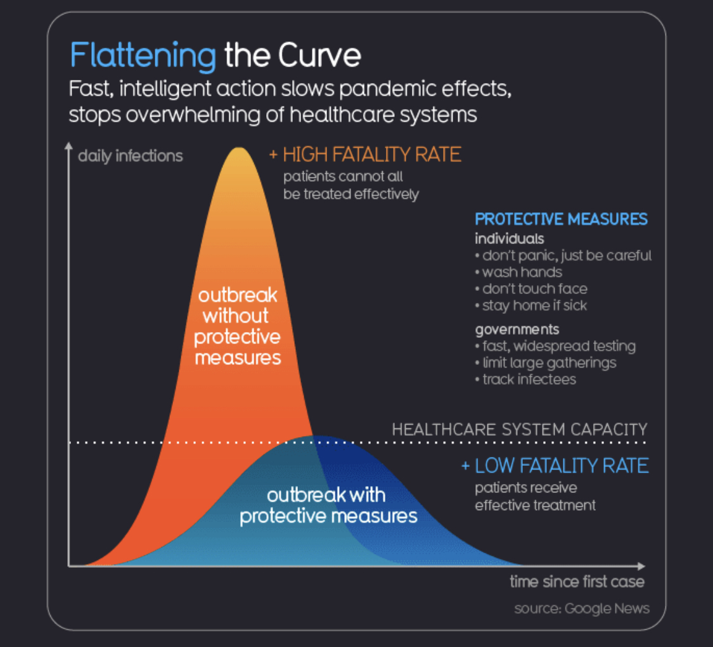

Slide 65
“Flatten The Curve”
Even the most conservative estimates project the disease burden to be extremely high.
We are well past the point of containment; mitigation strategies are needed in order for the healthcare system to remain effective.
Keeping the number of sick and hospitalized patients at one time gives the healthcare system a chance to function.
Healthcare systems must remain intact, Otherwise, morbidity and mortality levels will rise dramatically.

Slide 66
Data trackers and infographics
World Tracker: https://www.worldometers.info/coronavirus/
U.S.Tracker: https://coronavirus.1point3acres.com/en?fbclid=IwAR3A3clE1Ztxi-fNBgTWtVOobWuUBGFJ1S3NBPFlAaYVruBcAtzeOcqpIjQ
COVID19 slides/tables/graphs https://avatorl.org/covid-19/?page=ClinicalData1099

Slide 67
Myth: Coronavirus comes from Corona beer

Slide 69
Spread information, not germs
Lots of misinformation spreading, specially on social media
Patients and the general public look to medical personnel as sources of reliable information
Reiterate the importance of hand washing and limiting social interactions when appropriate
Flatten The Curve!

Slide 70
References:
UpToDate
CDC: https://www.cdc.gov/coronavirus/2019-ncov/index.html
WHO: https://www.who.int/health-topics/coronavirus
Online courses at: https://openwho.org/
https://www.worldometers.info/coronavirus/
Dr James Lawler Presentation at American Hospital Association/ National Ebola Training and Education Center
Dr. Lisa Gilbert MD lecture (Via Christi Family Medicine Residency)
Internet Book of Critical Care (IIBC) https://emcrit.org/ibcc/covid19/
The American Hospital Association https://sccm.org/Blog/March-2020/United-States-Resource-Availability-for-COVID-19?_zs=jxpjd1&_zl=w9pb6
The Society of Critical Care Medicine https://sccm.org/Blog/March-2020/United-States-Resource-Availability-for-COVID-19?_zs=jxpjd1&_zl=w9pb6
Infographics from Information Is Beautiful https://informationisbeautiful.net/visualizations/covid-19-coronavirus-infographic-datapack/

